Slide 1

Flight Delay Analysis* AA & Delta Across LGA, JFK & EWR Zohna Jones, Yafreisi Gonzalez, Mahesh D Nair
*All the airline logs are used for presentation purpose only, will not be used for any commercial purpose

Slide 2
Agenda
Motivation/Summary
Questions & Data
Data Cleanup & Exploration
Data Analysis:
Individual Observation Analysis
Consolidated Observations
Post Project
Questions

Slide 3
Motivation/Summary
Air travel is a $35.5 billion dollar industry (Forbes, 2019)
Flight delays are an inconvenience for passengers when trying to reach a job, meeting, or vacation destinations
Objective: Analyze delays for 3 airport per airline for 3 years
Hypothesis: Flight delays are mainly caused by weather
Findings:
Airport with most delays: LGA | Airport with least delays: EWR
Major cause for delays: Varies by airline/airport (Details in coming slides)
Most reliable airline: American Airlines at JFK,EWR, & LGA
Relational findings: Direct relations between delays and the delay causing
factors (using initial analysis)
Notes:
in minutes

Slide 4


Questions & Data
Questions:
Which airport/airline has most total delays?
Which airport/airline is most reliable?
What is the major cause for airline delays?
Is there any direct relation between departure delay and factors causing delays?
Data: Flight Delay data for American & Delta Airlines for area airports:
John F. Kennedy International Airport (JFK), Laguardia Airport (LGA), Newark Liberty International Airport(EWR) for 2017, 2018, 2019
Data Source: Bureau of Transportation Statistics

Slide 5
Data Cleanup & Exploration
Four main categories of Jupyter Notebooks *
Airport Analysis: American & Delta at JFK, LGA, EWR
Removed the heading and unwanted columns and grouped data by date and destination to arrive at date of delay and delay causing reason
Comparison Analysis of American vs. Delta
Consolidated all data between LGA,JFK and EWR for American and Delta to find out the most reliable and least reliable airport
Hypothesis from Airport Analyses
Defined a null hypothesis and plotted delay in minutes against all delay causing reasons to find direction relation (straight line) and performed Ptest to check null hypothesis
Mapping flight statistics
Combined all airports data by American and Delta and plotted Donut chart to show % delays and shown delay on Google maps on click on destinations (LGA, EWR and JFK)
* All data cleaning activities are automated (removing headings, finding maximum delay date and delay causing reason using keywords)
Notes:
Airport Analysis: American & Delta at JFK, LGA, EWR
Grouped data: date and departure delay and then by date & destination
Retrieved reasons for delays
Graphed/ran regression- reasons for delays
Comparison Analysis of American vs. Delta
Retrieved most/least reliable airport based on the airline
Hypothesis from Airport Analyses
Followed same procedure as individual analysis but ran t-test
Chart Flight Statistics
% On Time, %Delayed
Weather API from weather.com

Slide 6

Data Analysis
Individual Airport & Airlines

Slide 7

JFK – American - Analysis

Slide 8
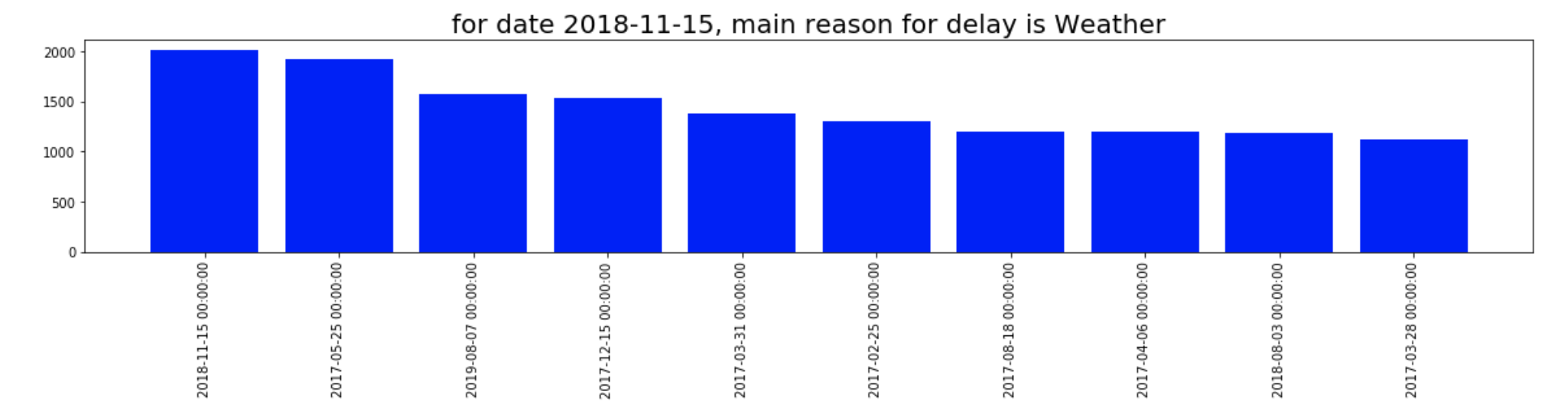
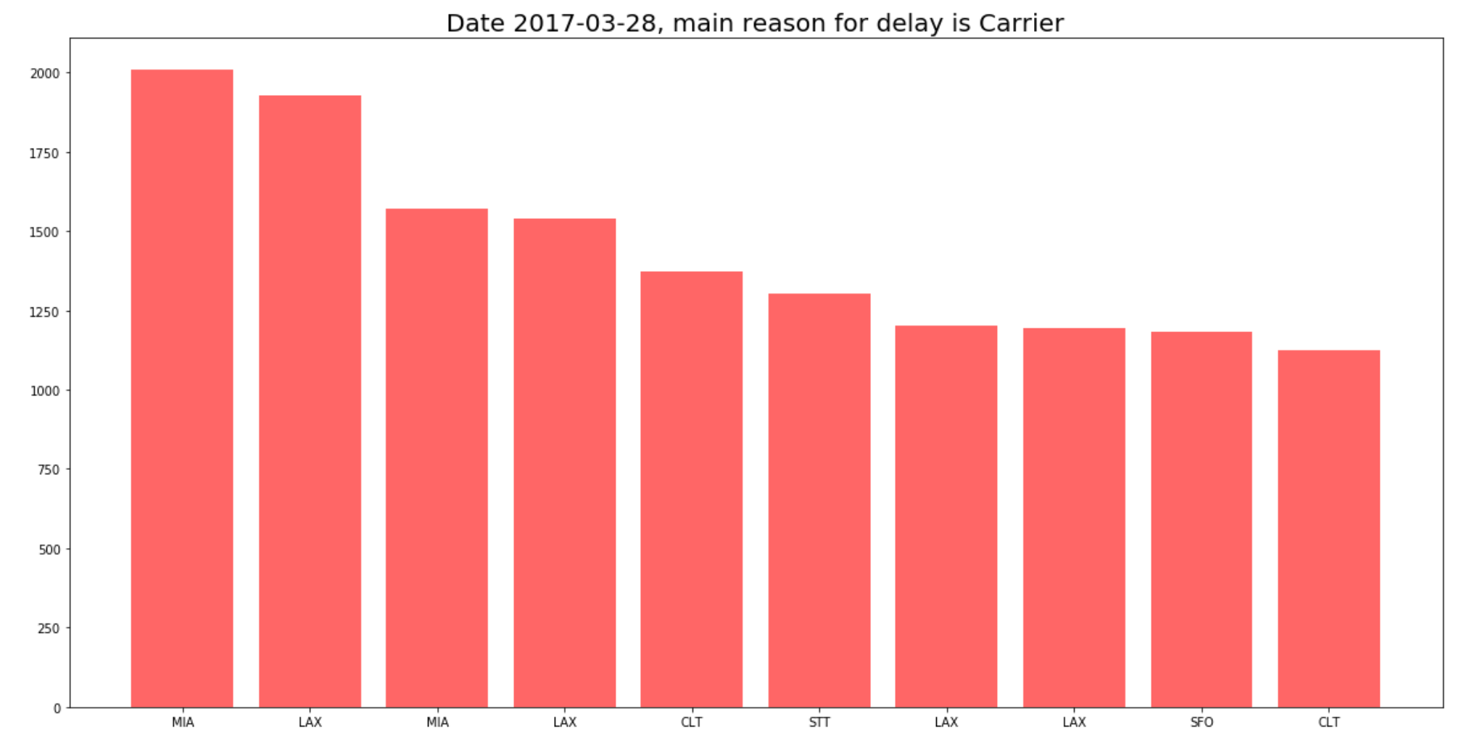
Observations
By Date
By Date & Destination
Notes:
JFk- American main cause for delay by date: weather and by date and destination as carrier
By date & destination→ Miami International Airport is the top day and destination for flight delays

Slide 9
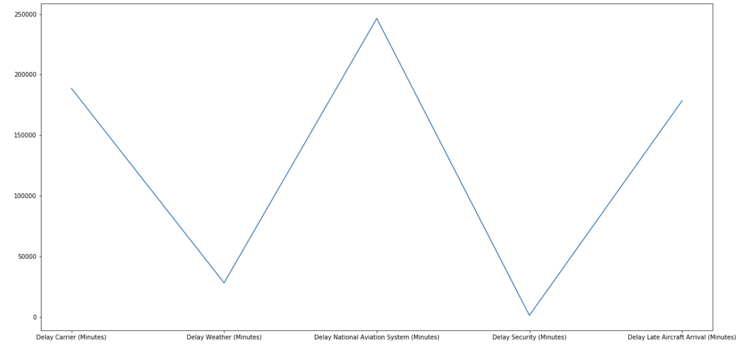
Observations
Delay in Minutes
Delay Reasons
Notes:
Even though one would think weather is the main cause of delay because of our weather pattern, the national aviation system has the highest delays minutes wise about 250,000 minutes over a three year period
National Aviation System delays→ any non-extreme weather event, air traffic control, operations

Slide 10
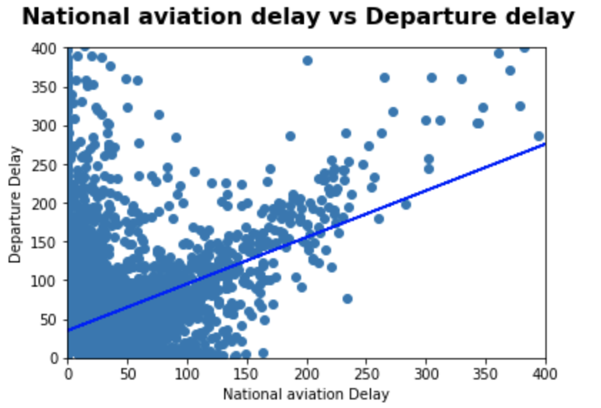
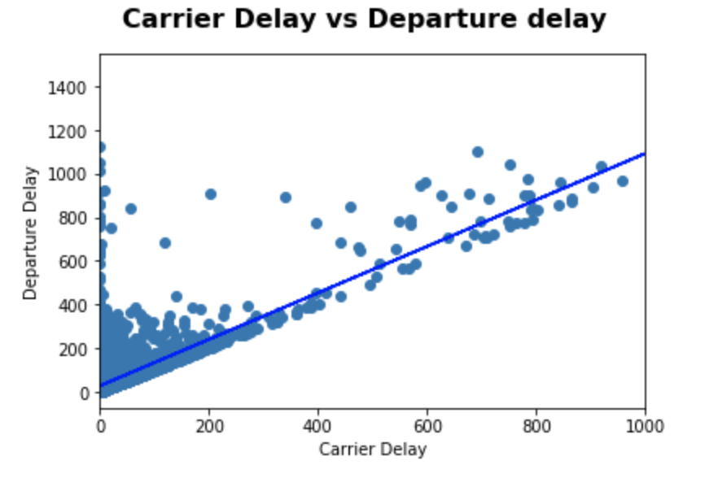
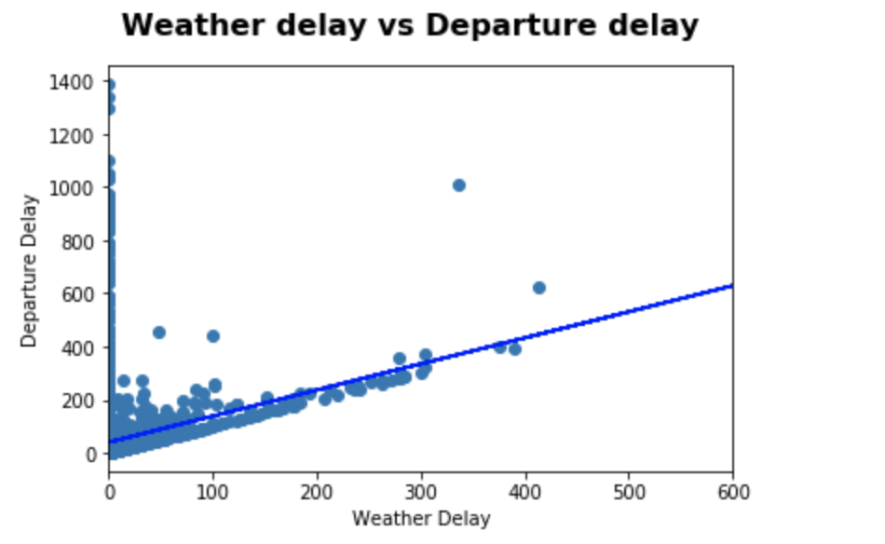
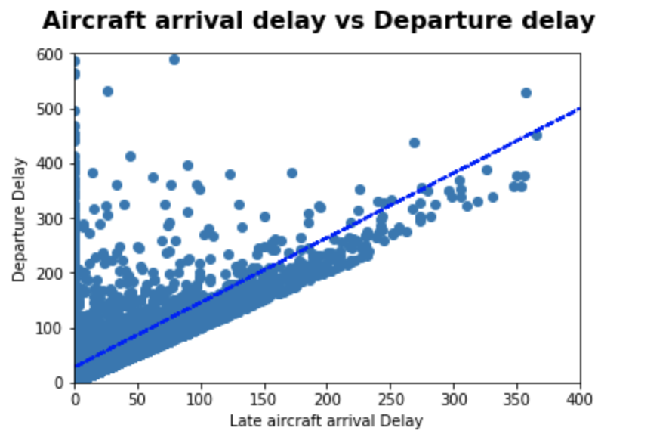
Null Hypothesis – Departure delay is only related to weather
Regression &
t-test results
Conclusion:
It shows that we cannot accept null hypothesis
Notes:
High positive correlation between the dependent variable→ Departure Delay and the independent variables→ national aviation, carrier, weather, and aircraft arrival delays
Even though hypothesis→ only weather→ can’t accept it based on the t test and p-value not just weather

Slide 11
EWR – American - Analysis

Slide 12
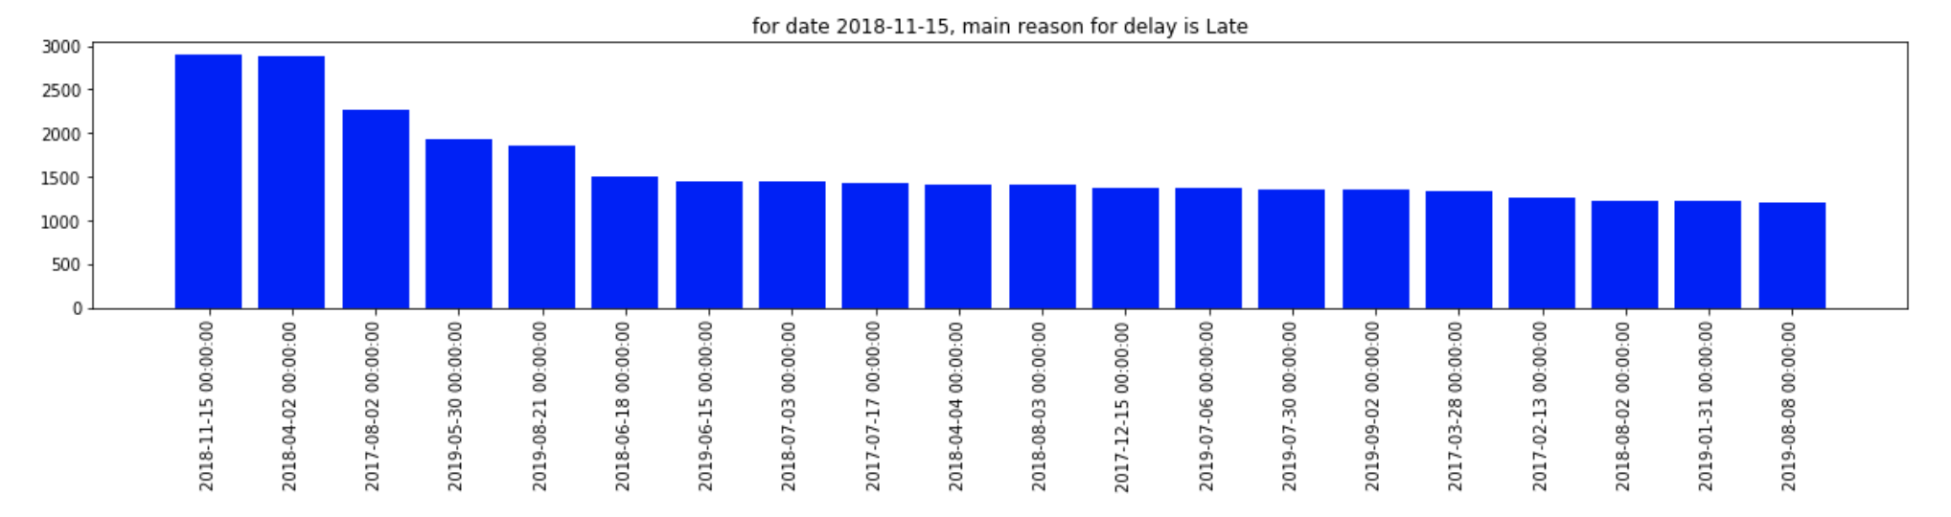
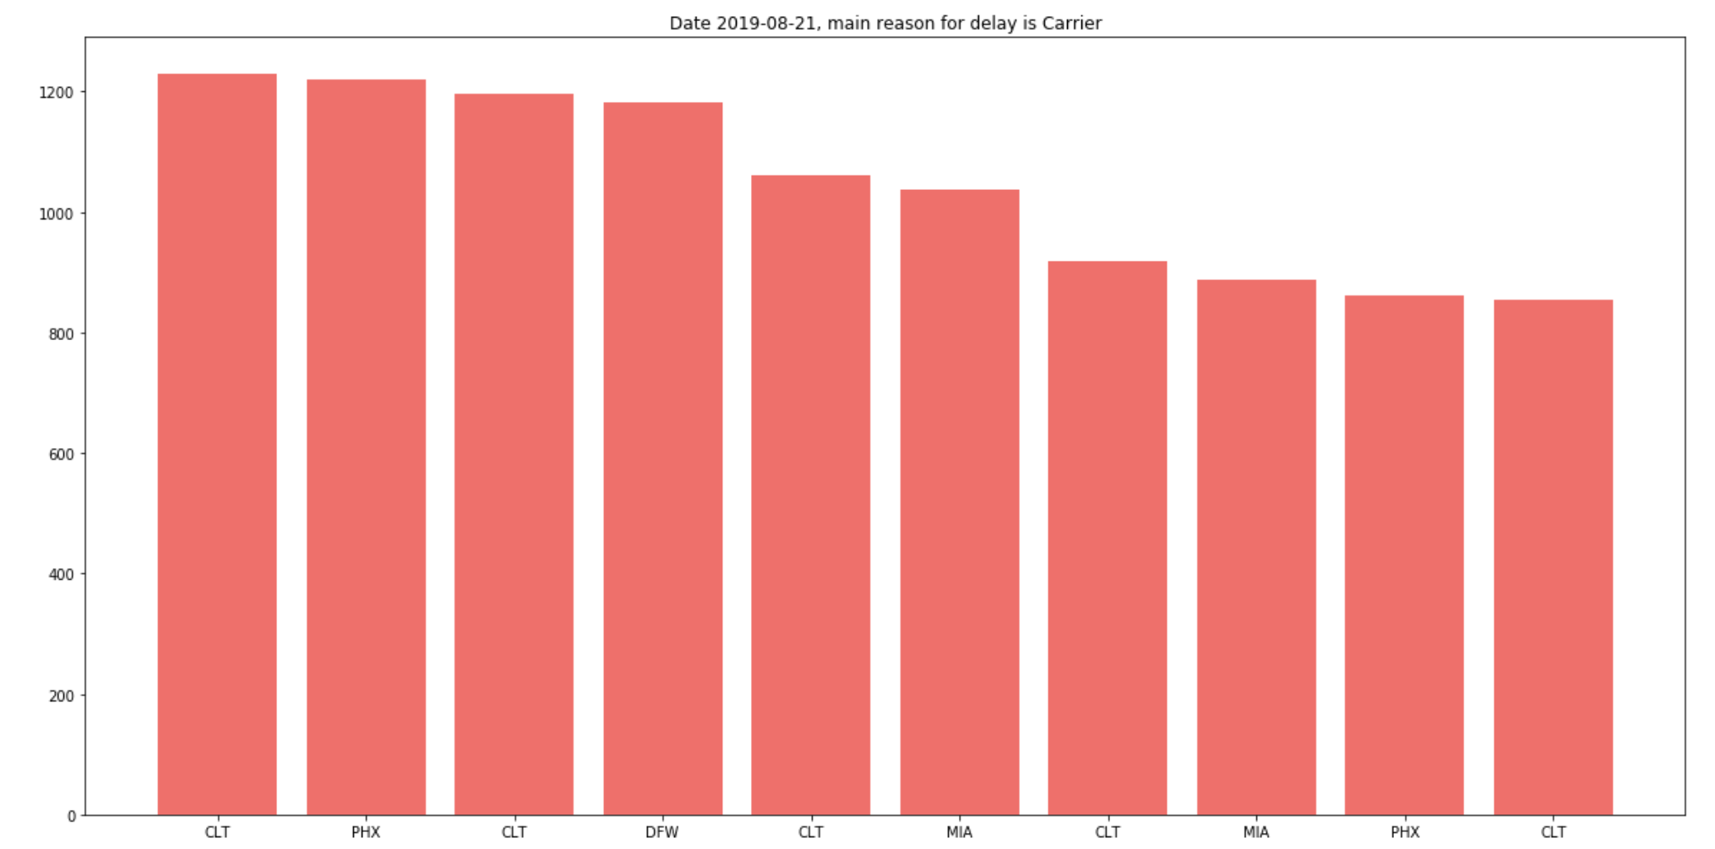
Observations
By Date
By Date & Destination
Notes:
EWR-American main cause of delay is late aircraft arrival,
Main cause for delay by date & destination is carrier related delay
By date & destination→ Charlotte Douglas International Airport on 8/21/19 was the top day and destination for delay

Slide 13
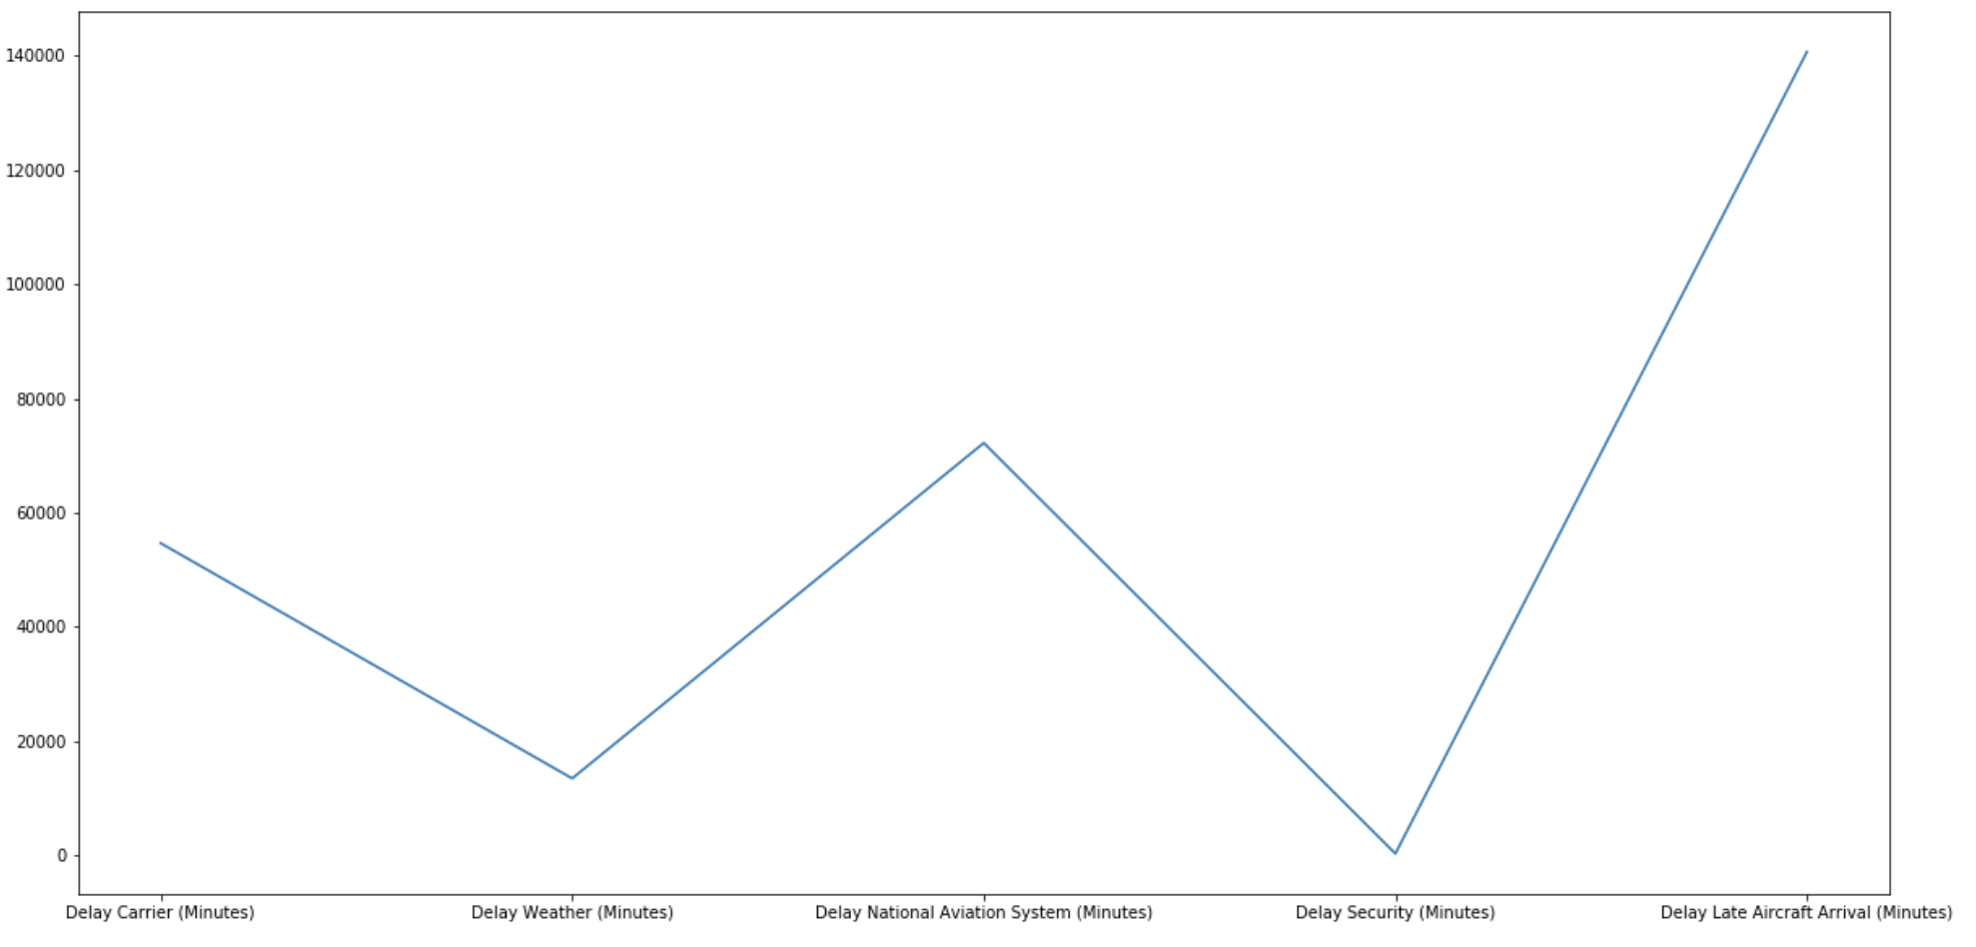
Observations
Delay in Minutes
Delay Reasons
Notes:
National Aviation System delays have the highest amount of delays in minutes---> about 80,000 over 3 yr period

Slide 14
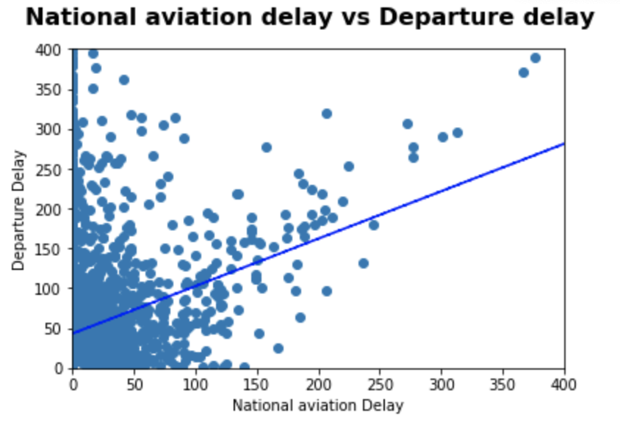
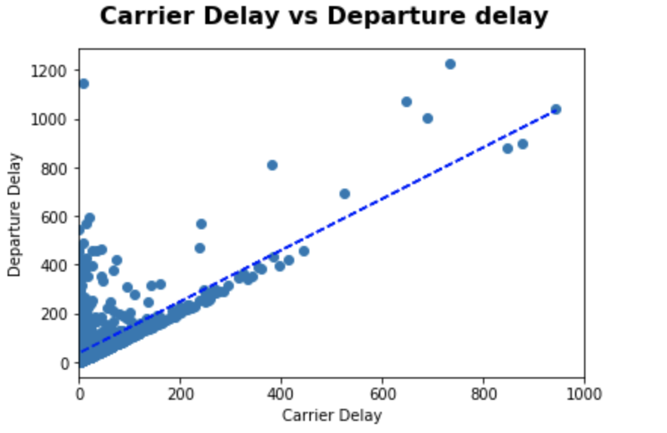
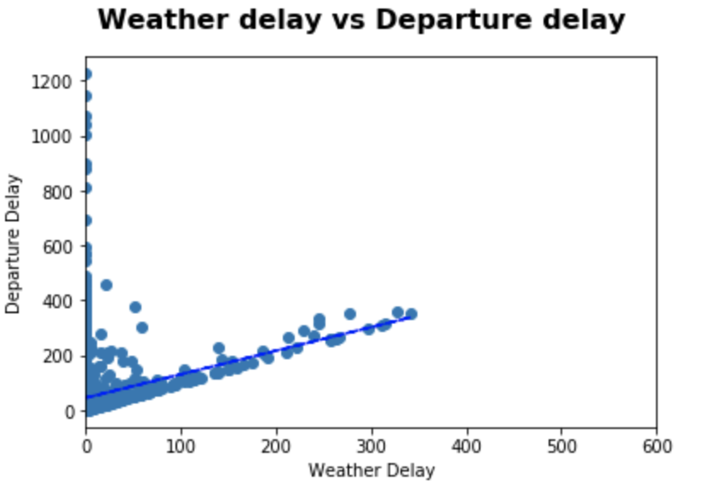
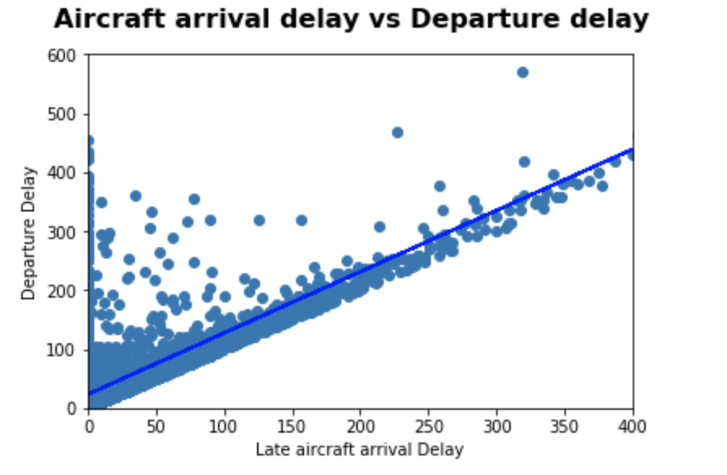
Null Hypothesis – Departure delay is only related to weather
Regression and
t-test results
Conclusion:
It shows that we cannot accept null hypothesis
Notes:
High positive correlation between dependent variable (Departure Delay) and independent variables NAS, Carrier, Aircraft, Weather
reject null hypothesis because of

Slide 15
LGA – American - Analysis

Slide 16
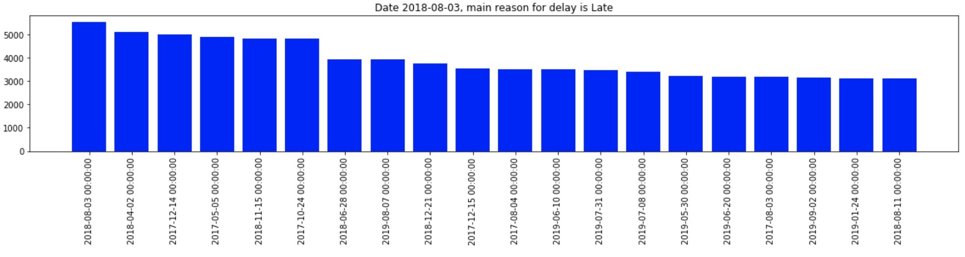
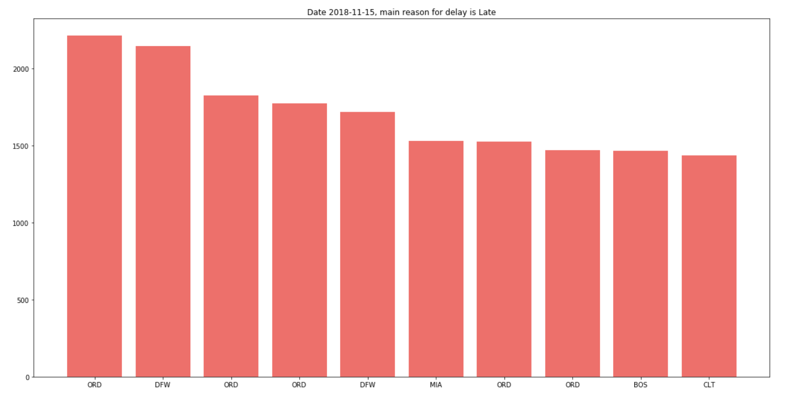
Observations
By Date
By Date & Destination
Notes:
LGA-American main cause for delay by date and by date & destination is late aircraft arrival
Top delays to Chicago O’Hare International Airport on 11/15/18 when looking at date and destination

Slide 17
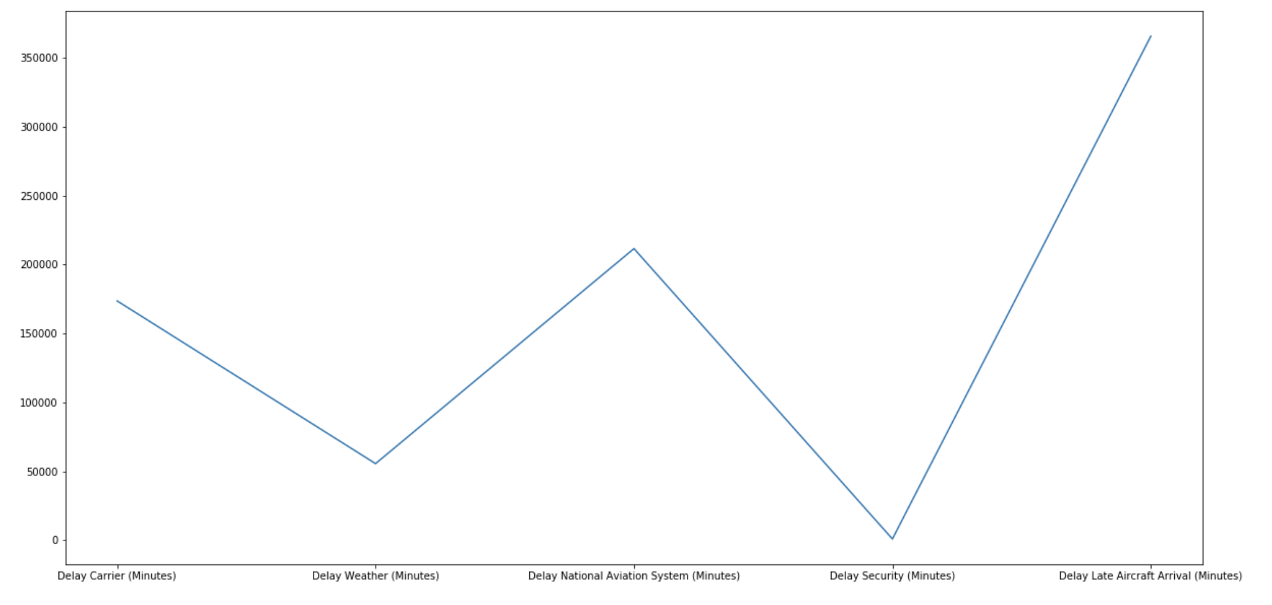
Observations
Delay in Minutes
Delay Reason
Notes:
Main delay reason National Aviation System over 3 years also almost 80,000 in minutes

Slide 18
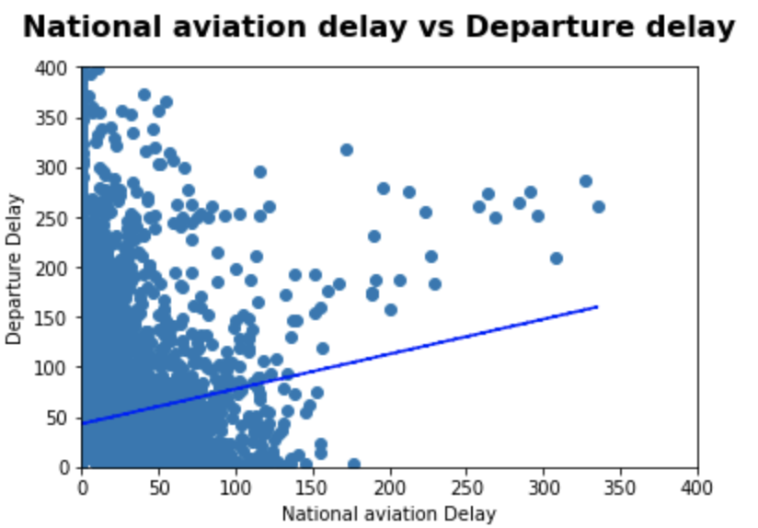
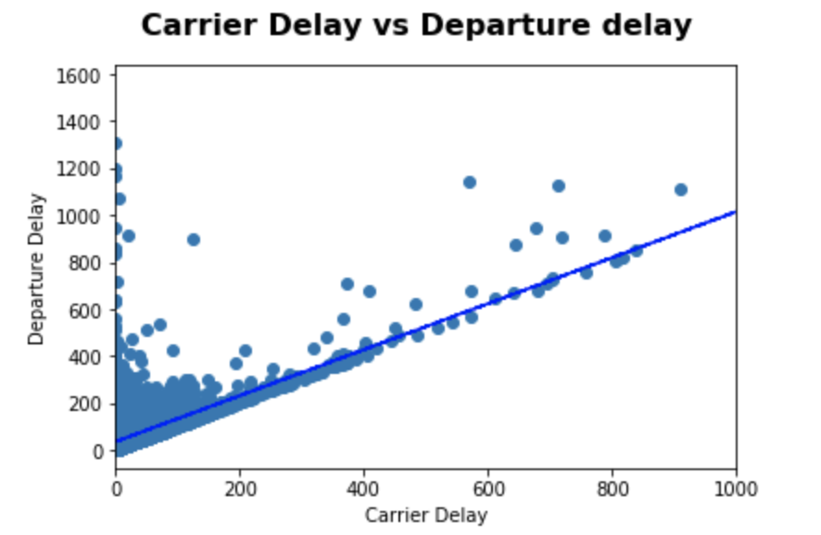
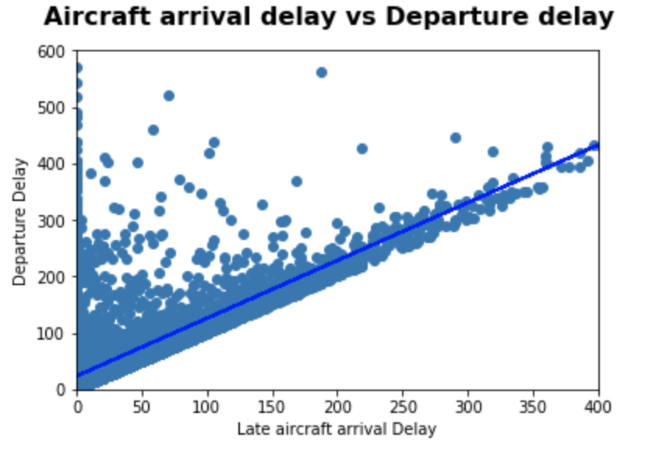
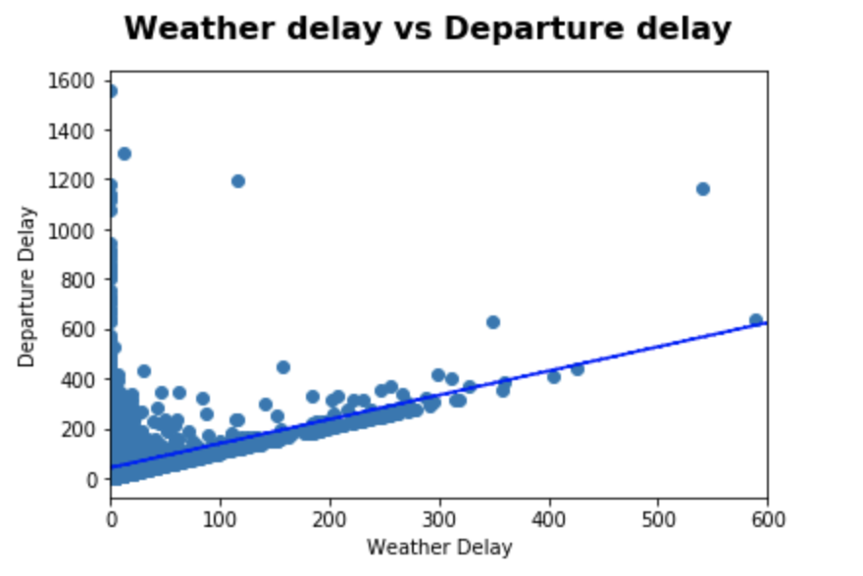
Null Hypothesis – Departure delay is only related to weather
Regression and
t-test results
Conclusion:
It shows that we cannot accept null hypothesis

Slide 19
JFK – Delta - Analysis

Slide 20
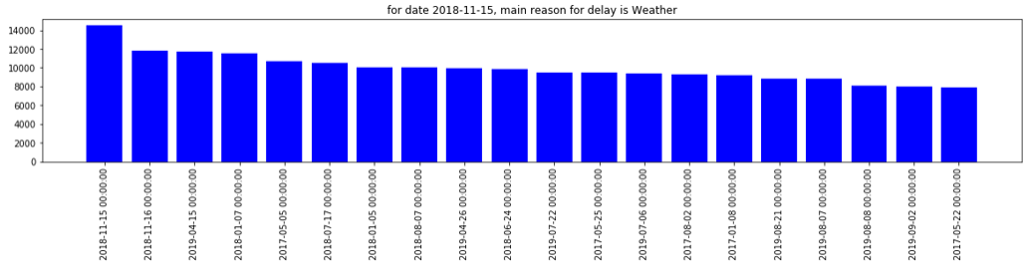
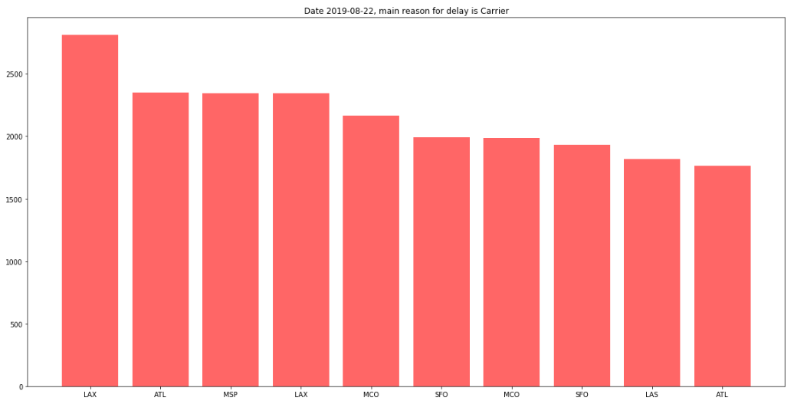
Observations
By Date
By Date & Destination

Slide 21
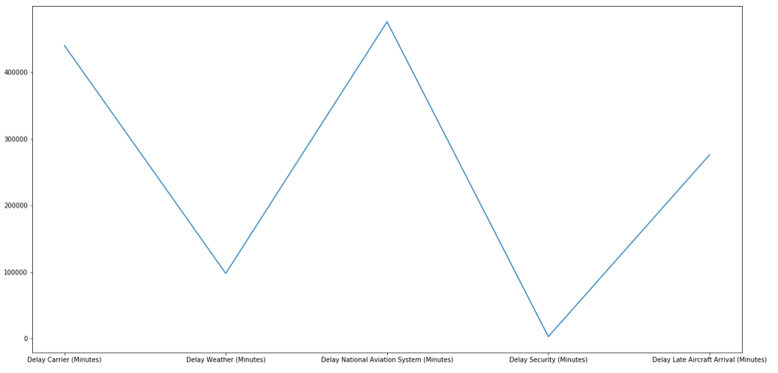
Observations
Delay in Minutes
Delay Reasons

Slide 22
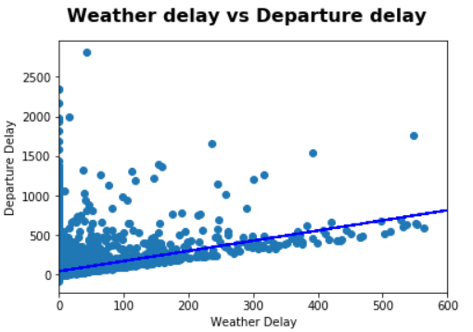
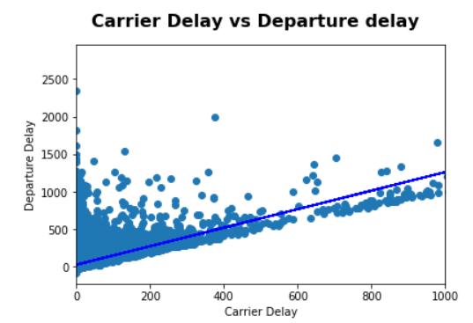
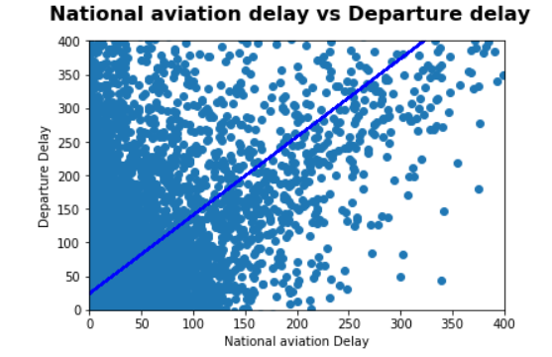
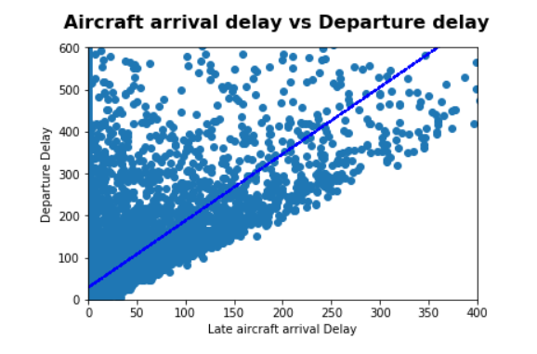
Null Hypothesis – Departure delay related to weather
Regression and
t-test results
Conclusion:
It shows that we cannot accept null hypothesis

Slide 23
EWR – Delta - Analysis

Slide 24
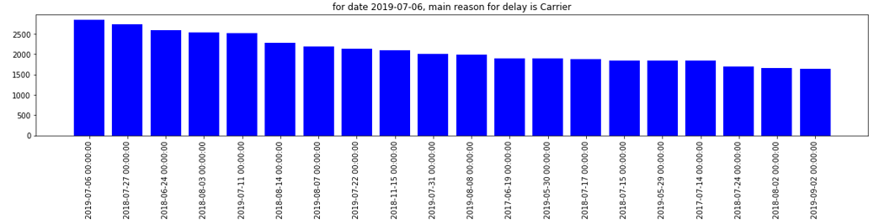
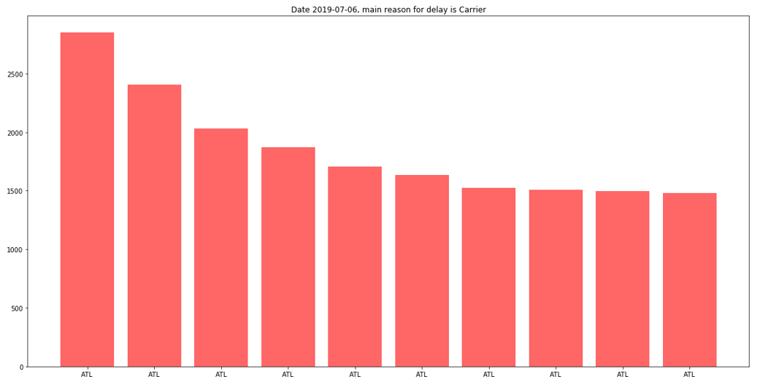
Observations
By Date
By Date & Destination

Slide 25
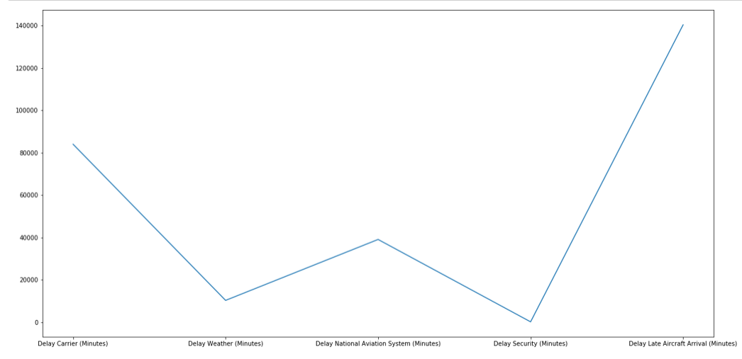
Observations
Delay in Minutes
Delay Reasons

Slide 26
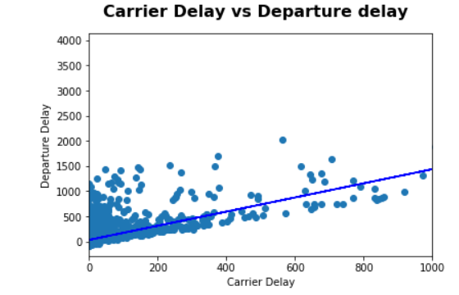
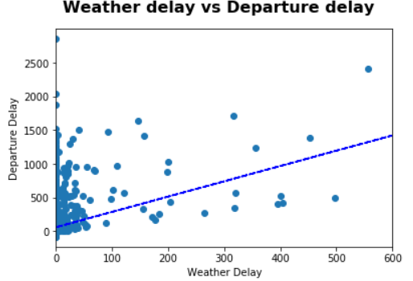
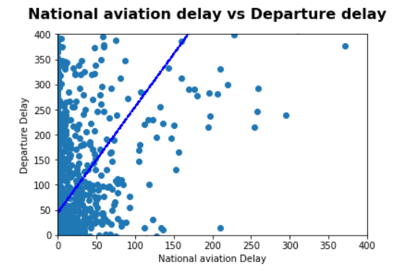
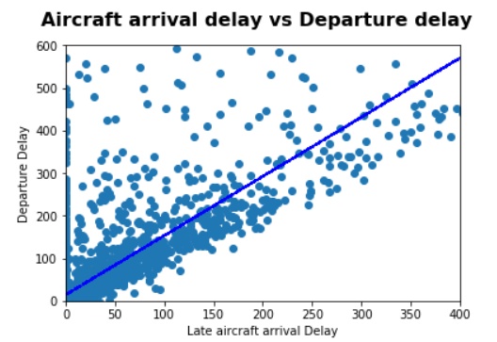
Null Hypothesis – Departure delay related to weather
Regression and
t-test results
Conclusion:
It shows that we cannot accept null hypothesis

Slide 27
LGA – Delta - Analysis

Slide 28
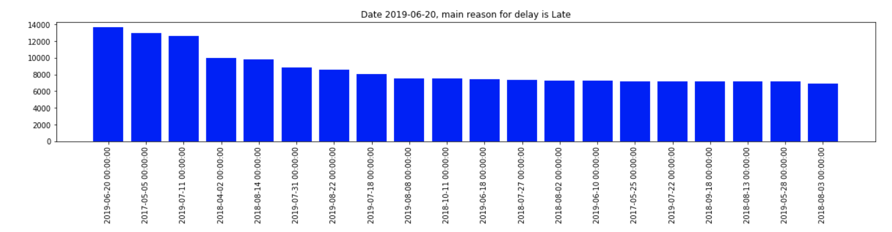
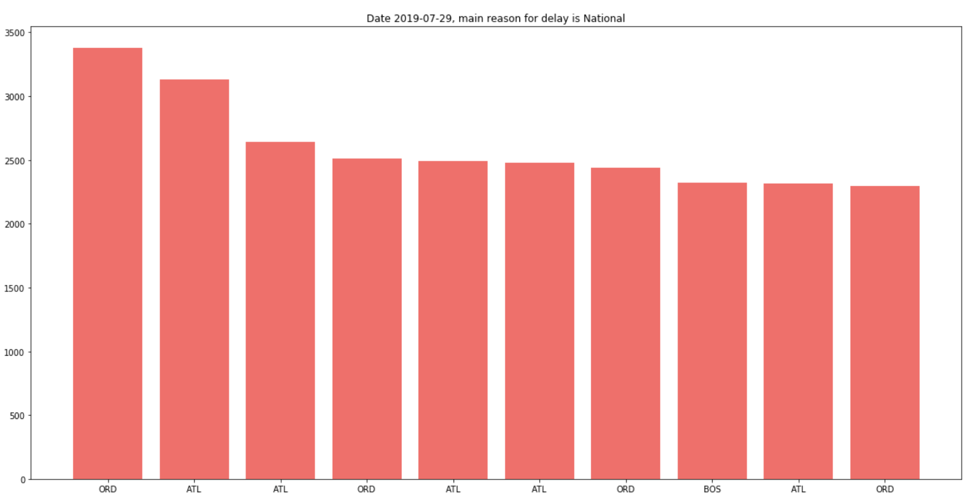
Observations
By Date
By Date & Destination
Notes:
From the data for 2017,2018 and 2019 (until 09/30), below is the flight delay details

Slide 29
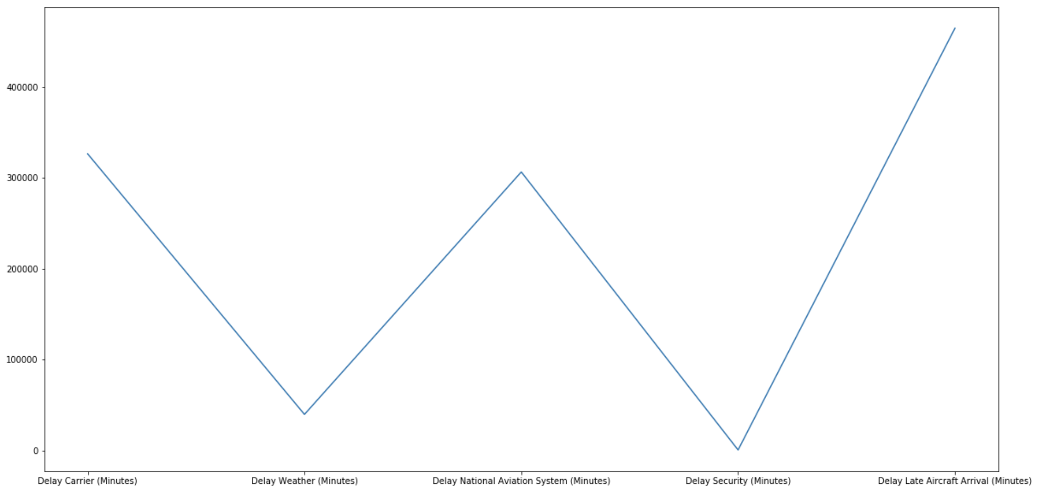
Observations
Delay in Minutes
Delay Reasons

Slide 30
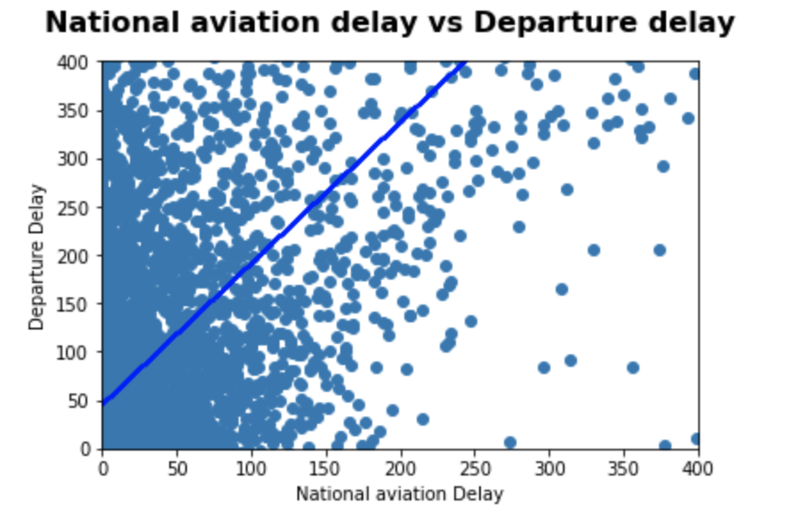
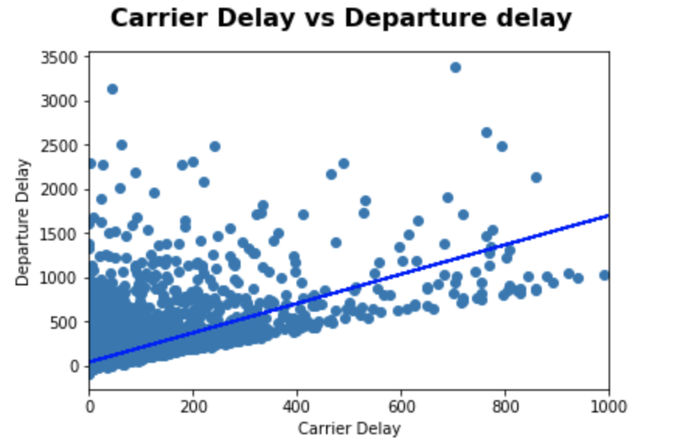
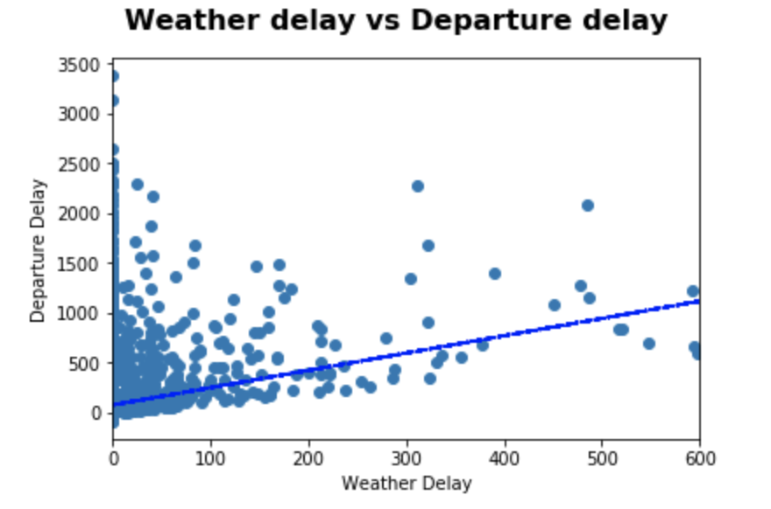
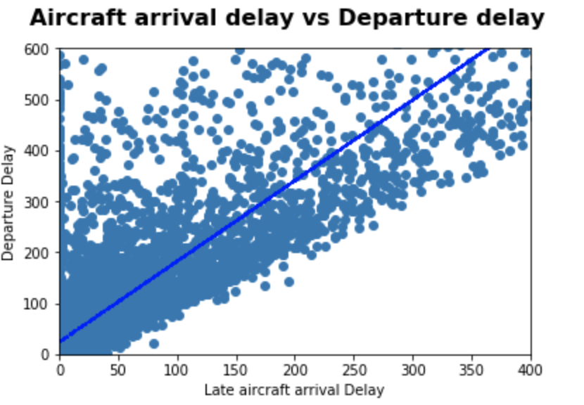
Null Hypothesis – Departure delay only related to weather
Regression and
t-test results
Conclusion:
It shows that we cannot accept null hypothesis

Slide 31
Data Analysis
Consolidated Observations

Slide 32
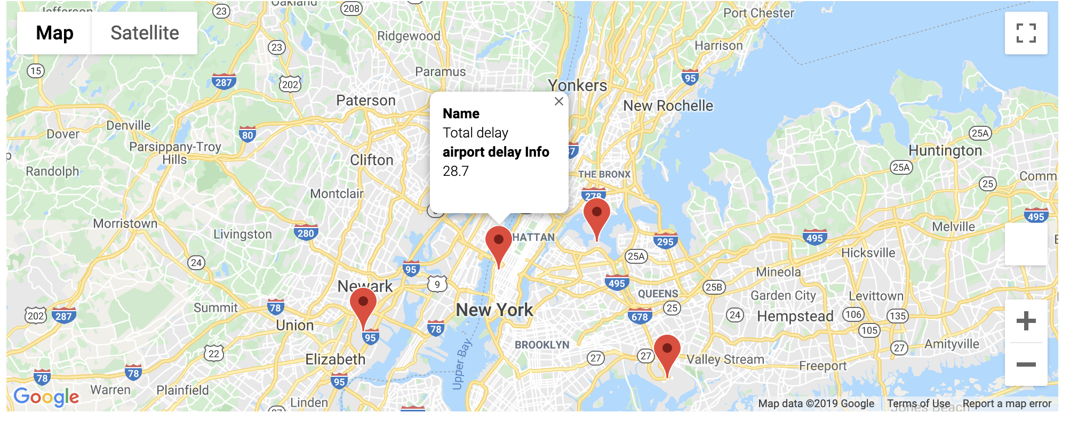
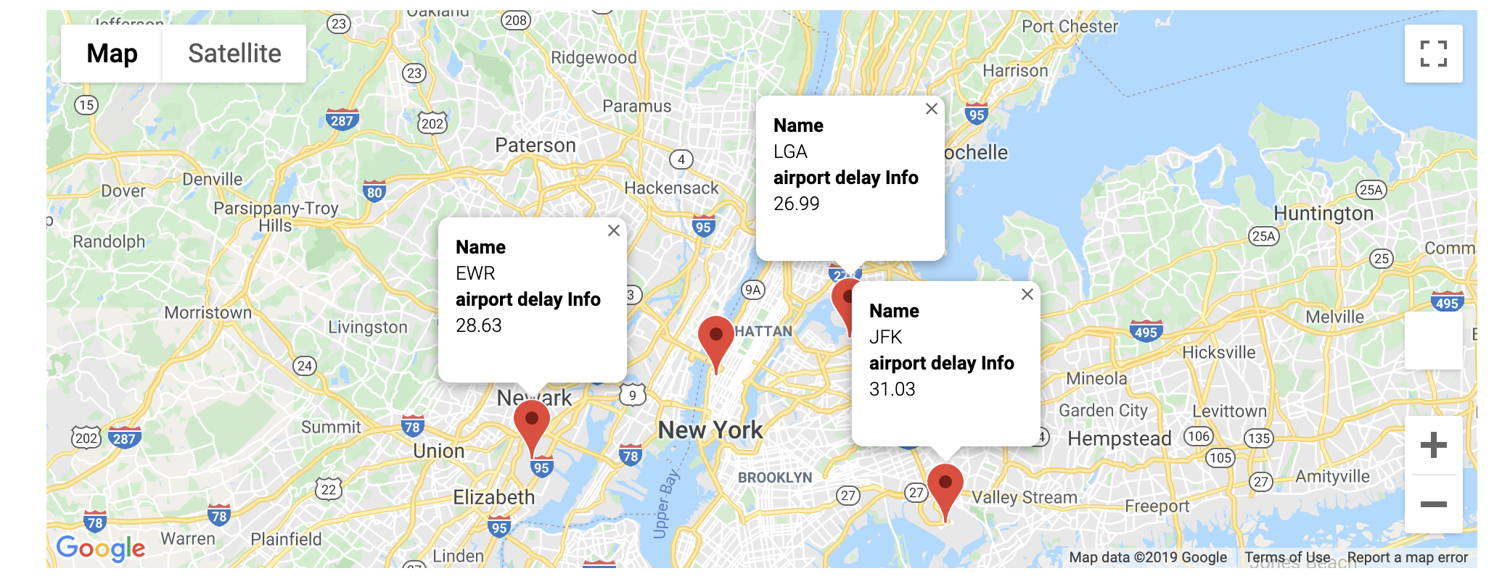
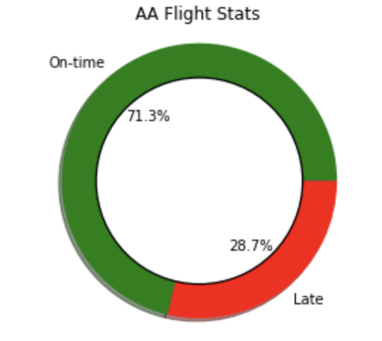
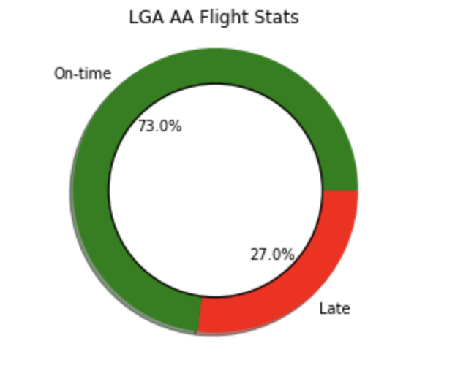
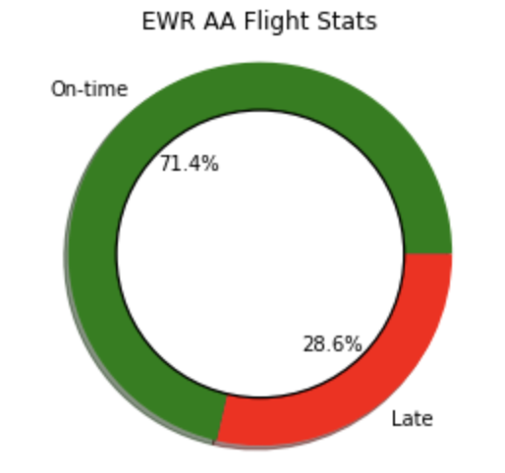
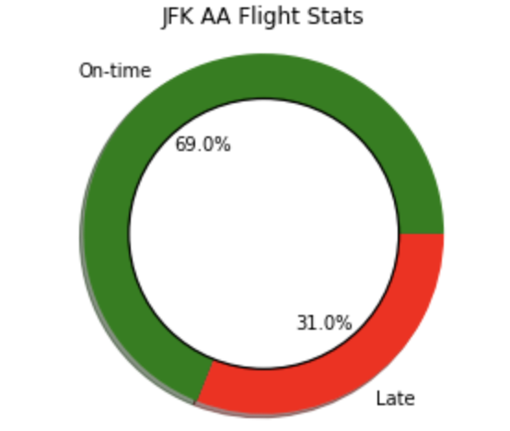
View on Airport delay (by Number of Aircrafts) - American

Slide 33
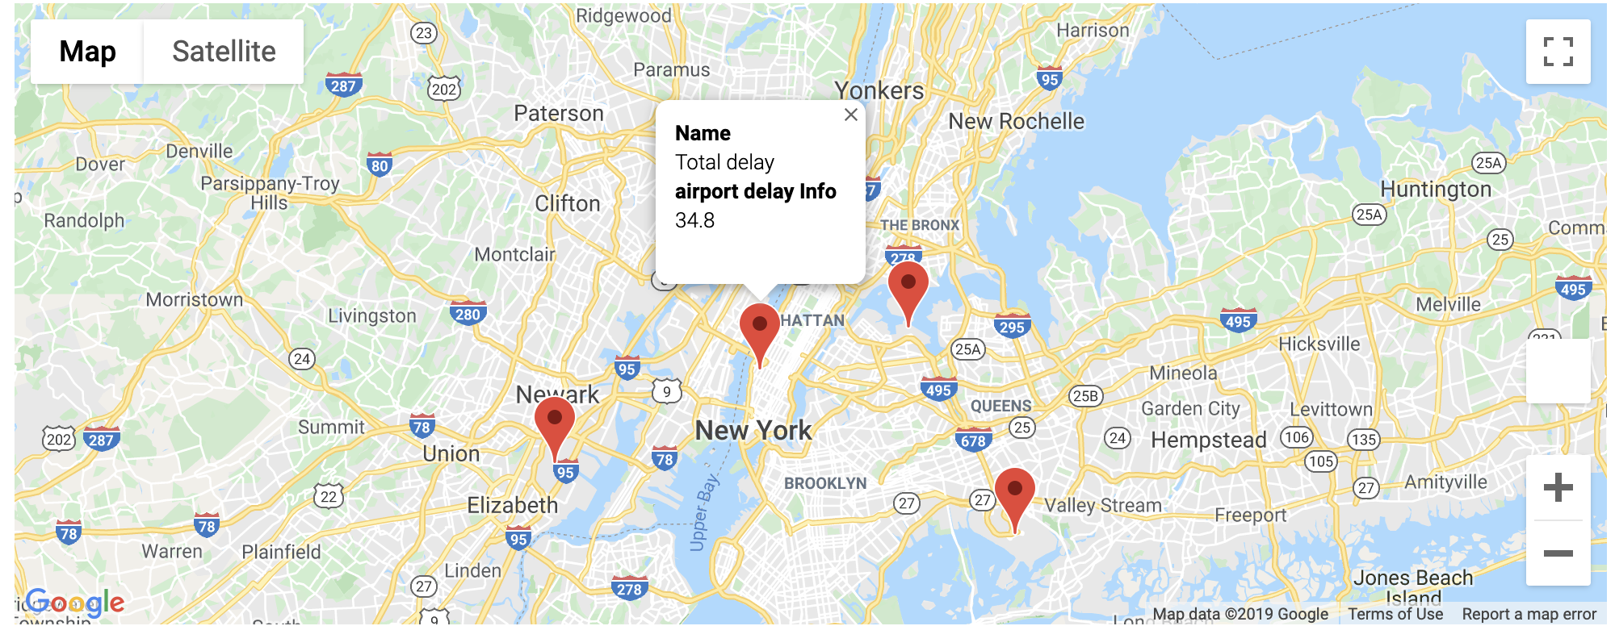
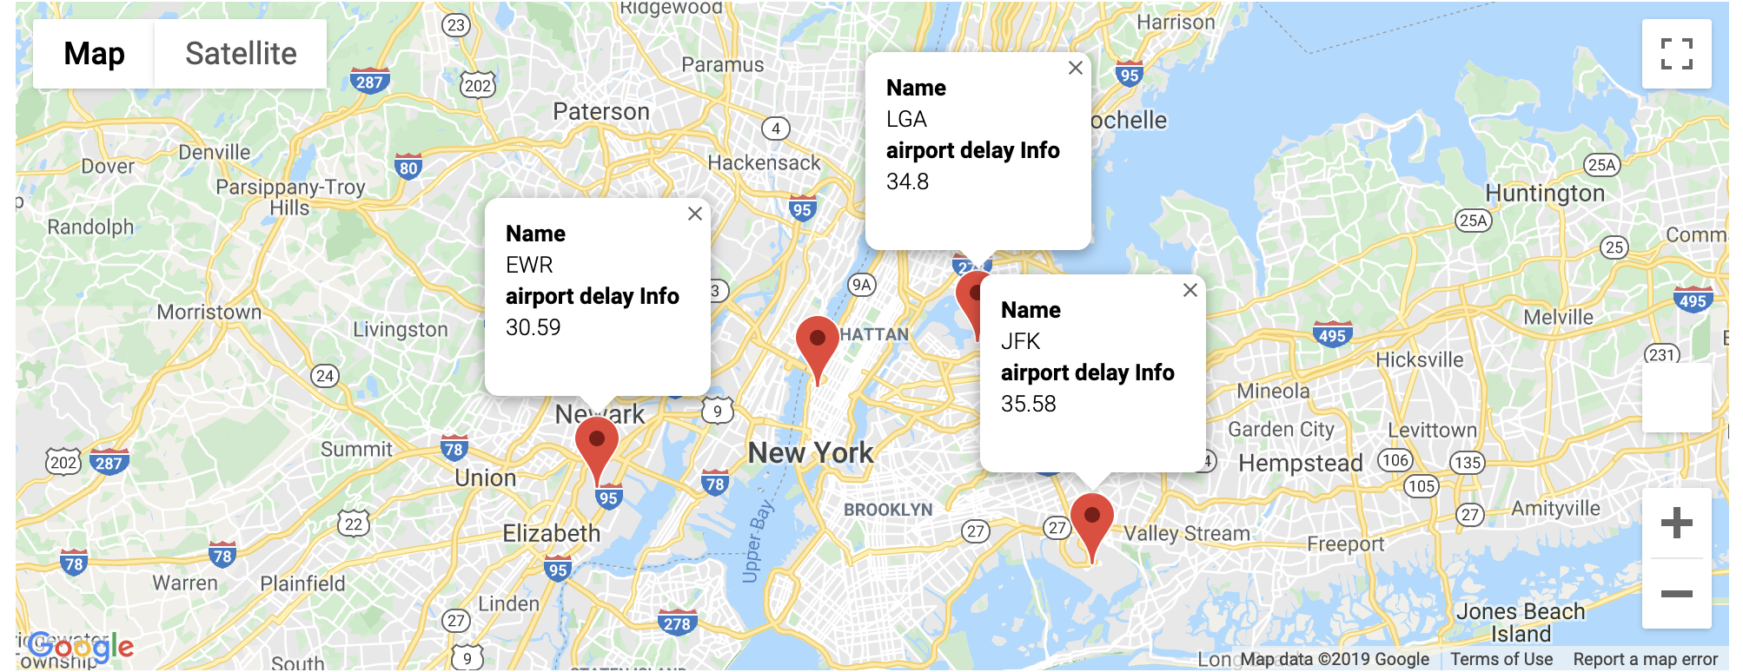




View on Airport delay (by Number of Aircrafts) - Delta

Slide 34
Post Analysis
What went well:
Dividing Group Work: worked with each other’s strengths
Group Communication
What need improvement:
Don’t get bogged down with data
Diving deeper into flight delays for more airlines and airports
What should have helped:
Data storage solution would have been great help
Good understanding of HTML and Javascript
Research Next:
Examine flight patterns with weather API by creating a heatmap of flight delays across the country
Coordinating top delay destinations to heatmap across the US
Deep dive into statistical methods (Delay trends) of analysis and predicting delays for a future date
Notes:
We were going to analyze United Airlines but found it was too much, as we started to clean the data.

Slide 35
Appendix

Slide 36


Data cleanup
with open(file_to_load1) as csv_file:
csv_reader = csv.reader(csv_file, delimiter=',')
line_count = 0
for row in csv_reader:
if row == []:
line_count += 1
break
else:
line_count += 1
jfk_aa_data = pd.read_csv(file_to_load1,skiprows=line_count)
Automated population of Delay Date and Delay Reason
for i in range(n-1):
if jfk_check_reason_check.columns[i].split(" ")[0] == "Delay":
print(jfk_check_reason_check.columns[i])
value.append(jfk_check_reason_check.iloc[0][i])
heading.append(jfk_check_reason_check.columns[i])
jfk_check_reason_check.iloc[0][0]
reason=heading[value.index(max(value))]

Slide 37

Plotting Donut
delay = df5['Departure delay (Minutes)'].count()/df4['Departure delay (Minutes)'].count()
delay=round(delay*100,2)
ontime = 100-delay
# The slices will be ordered and plotted counter-clockwise.
labels = 'On-time', 'Late'
sizes = [ontime,delay]
colors = ['green', 'red']
explode = (0, 0) # explode a slice if required
plt.pie(sizes, explode=explode, labels=labels, colors=colors,
autopct='%1.1f%%', shadow=True)
#draw a circle at the center of pie to make it look like a donut
centre_circle = plt.Circle((0,0),0.75,color='black', fc='white',linewidth=1.25)
fig = plt.gcf()
fig.gca().add_artist(centre_circle)
# Set aspect ratio to be equal so that pie is drawn as a circle.
plt. title("AA Flight Stats")
plt.axis('equal')
plt.savefig("AA-flight-stat.png")

Slide 38
Google Maps and data on click
import gmaps
gmaps.configure(api_key="AIxxxxxxxxxxxxxxxxxxxx")
fig = gmaps.figure()
LGA = (40.7769271,-73.87396590000003)
JFK = (40.6441666667,-73.7822222222)
EWR = (40.6895314,-74.17446239999998)
airports=[
{"name":"JFK","location":(40.6441666667,-73.7822222222),"airport_info":delay_jfk},
{"name":"LGA","location":(40.7769271,-73.87396590000003),"airport_info":delay_lga},
{"name":"EWR","location":(40.6895314,-74.17446239999998),"airport_info":delay_ewr},
{"name":"Total delay","location":(40.75, -74.00),"airport_info":delay}
]
airport_locations = [airport['location'] for airport in airports]
info_box_template = """
<dl>
<dt>Name</dt><dd>{name}</dd>
<dt>airport delay Info</dt><dd>{airport_info}</dd>
</dl>
"""
airport_info = [info_box_template.format(**airport) for airport in airports]
marker_layer = gmaps.marker_layer(airport_locations,info_box_content=airport_info)
fig = gmaps.figure()
fig.add_layer(marker_layer)
fig

Slide 39
QUESTIONS?

